Slide 1
Design patterns
C# edition
Overview and examples

Slide 2
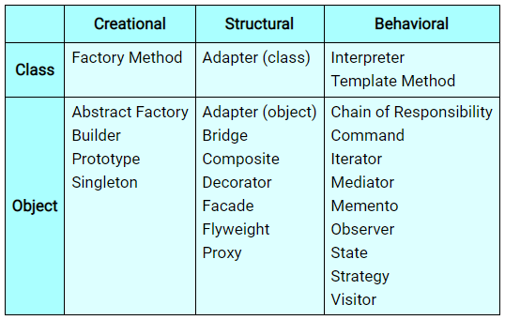
Types of design patterns

Slide 3
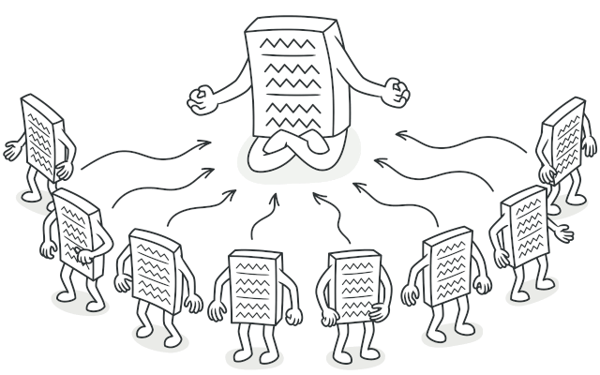
1. Singleton
CREATIONAL
Characteristic
Ensure to create and reuse always the only one instance of some object, class (e.g. Controller or parts of other design patterns: like abstract factory, factory method, builder, strategy, state…), or resources (e.g. file with logs and other information, database, cached data - which initialization is repetitive and pretty expensive).

Slide 4
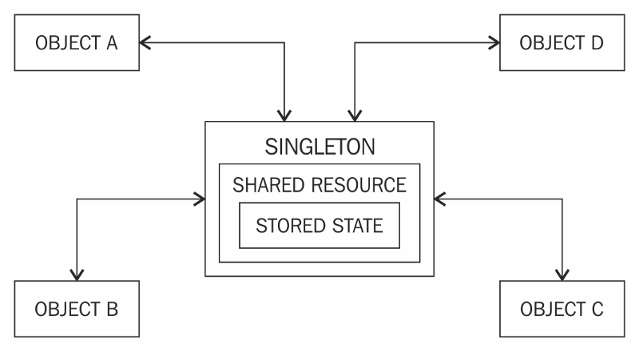
The purpose:
Controls occurrences: When you need to have only 1 instance of some object to not mess with the context
(e.g. database) or to not create unnecessary duplicates (many files, many instances).
Caching the instance: To prevent initializing the same object all the time, again and again, to avoid unnecessary
overhead and to improve the performance.
Controls access to shared resource (e.g.: public static) from other places
to aggregate and synchronize data.
Singleton is treated as a gatekeeper.

Slide 5
Benefits and costs of using:
Pros:
Cons:
+ Creation of instance is fast and easy: once made effort, to set up creation of instance properly, is ready to reuse (automatically) later. You do not need to think about it any further.
+ Encapsulation of the code: The object initializa-tion is hidden and safe from modifications.
+ The instance is easily accessible: Usually it is public and static object called „Instance” or re- quested on demand by „GetInstance” method.
- Difficult to test: A Singleton might cause issues for writing testable code if the object and the methods associated with it are so tightly coupled that it becomes impossible to test with-out writing a fully-functional class dedicated to the Singleton.
- Singletons create hidden dependencies: As the Singleton is readily available throughout the code base, it can be overused. And because its reference is not completely transparent while passing to different methods, it becomes difficult to track.
- That’s why singleton is considered by many developers as antipattern (if overused).

Slide 6
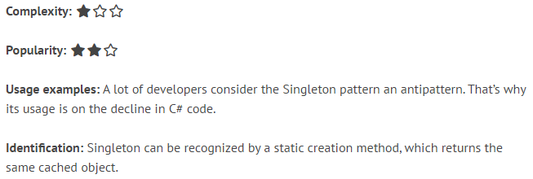

Resources:
Singleton is very easy design pattern,
which does not require any complex structure of folders, inheritance or logic flow. It can be even „one liner”.
https://refactoring.guru/design-patterns/singleton/
https://refactoring.guru/design-patterns/singleton/csharp/example/
Singleton design pattern is popular
because it is a universal and pretty
natural way (even if you do not know
this pattern is even existing) how to
control instances of your objects/data
https://dofactory.com/net/singleton-design-pattern
https://csharpindepth.com/Articles/Singleton

Slide 7
Implementations:
Returns the cached instance of a selected class (which is singleton) or create a new instance of this class if any instance is not existing yet.
This implementation will create singleton instance on demand (Using such, on-demand, strategy is called „lazy initialization”).
Remember about thread-safe design in the future for
other implementa-tions as well ☺
Lazy initialization (methods):
Thread-safe implementation:
public class SomeSingletonClass
{
private static SomeSingletonClass _instance; // null by default
public static SomeSingletonClass GetInstance()
{
if (_instance == null) // Check if instance is existing
{
_instance = new SomeSingletonClass();
}
return _instance; // Return cached instance
}
private SomeSingletonClass(); // To prevent calling constructor
}
public class SomeSingletonClass
{
private static SomeSingletonClass _instance; private static readonly object padlock = new object();
public static SomeSingletonClass GetInstance()
{
lock (padlock) // Prevent exceptions when many threads wants
{ to paralel access the same resource „_instance”
if (_instance == null)
{
_instance = new SomeSingletonClass();
}
return _instance;
}
}
private SomeSingletonClass(); // To prevent calling constructor
}

Slide 8
Implementations:
Initializes instance of some class immediatelly and then return it
when user is asking (new implementations will not be created)
Instant initialization (read-only properties):
public static class SomeSingletonClass // Prevent creating instance of this class from construtor „new”
{
public static ClassToInitialize Instance { get; } = new ClassToInitialize(); // Static read-only property with overriden default value
}
public sealed class SomeSingletonClass // Additional protection („sealed”) to not override this class and create its instance from child class
{
public static SomeSingletonClass Instance { get; } = new SomeSingletonClass(); // Static read-only property with overriden default value
private SomeSingletonClass() { } // Forbid creating instance of this class from constructor(!)
}

Slide 9
Implementations:
Initializes instance of some class immediatelly and then return it
when user is asking (new implementations will not be created)
Instant initialization (static constructor):
DIFFERENT TYPES OF CONSTRUCTORS IN C#:
1. Default constructor (parameterless):
public Cat() { } // Parameterless (e.g. EntityFramework require them to be always implemented!)
-------------
2. Custom constructor (with parameters):
public Cat(string name) { } // With parameters
--------------
3. With restricted accessibility:
private Cat() { } // Forbid using constructor of this class(!)
protected Cat() { } // Can call only from children => BabyCat : Cat
----------------
4. Static constructors:
static Cat() { } // Is called only once when class is created
public static class SomeSingletonClass
{
public static readonly ClassToInitialize Instance; // Field
static SomeSingletonClass() // Static constructor
{
Instance = new ClassToInitialize();
}
}

Slide 10
Use cases:
Working with database:
Working with other patterns:
private DbContext _context = DbContext.GetInstance();
public void Connect()
{
_context.Connect();
// OR, without private field
DbContext.Instance.Connect();
}
var factory = ServiceFactory.GetInstance();
var service = factory.Create(ServicesEnum.Broadcaster);
decimal taxRate = 28.0m;
var strategy = new IncomeAfterTax(taxRate);
var calculationStrategy = Strategy.Instance;
calculationStrategy.SetContext(strategy);
calculationStrategy.Process();

Slide 11
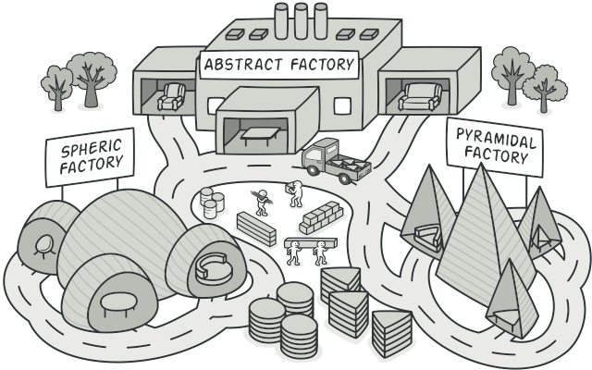
2. Abstract Factory
CREATIONAL
Characteristic
Simplifies creation of custom or predefined models. The creation process of a specific objects is managed from a single specialized (concrete) factory class. The factory can be used and extended easily for unlimited creation possibilities (SOLID Principles).

Slide 12
The purpose:
Easier way to create objects: Wrapping the logic responsible for creating (and usually already customizing and
pre-initializing) defined types of models, so, the developer does not need to re-
member about all of the initialization steps – only using a single method.
Easier to handle models: As a result of introducing Factory architecture, models are inlined and well organized.
It is also easier to find and differentiate specific implementations and base, shared code.
Keeps the architecture clean: Helping to follow Open-Closed Principle (SOLID), because creation of a new model
only extends (updates) an already existing implementation – changing is not needed.
Makes the code look better: Using single statements (usually “Create(xyz)” or “Get(xyz)” methods) are way cleaner,
easier to understand and more elegant to use, than a full, long new() initializations.

Slide 13
Benefits and costs of using:
Pros:
Cons:
+ Usage is simplified: The only thing to do is to get an instance of factory and to use its method with predefined input arguments (type of object to be created by Abstract Factory).
+ Good organization of a code: Usually, you are introducing a separate folders structure to keep your concrete factories, and models which can be managed by them.
- Need to handle additional dependency: You need to pass and manage somehow the usage of Factory implementation. Pro- bably Dependency Injection would be required. So, we can say this is an additional effort (like most design patterns).
- Introducing an overhead to a project: Some people probably may consider this solution as an overhead if you have only a few models in your project. Abstract Factory implementation can be treated as a full scale change in the project and some-times it is beneficial to just use Factory Method or to just use new() statement with a proper, short initialization.

Slide 14
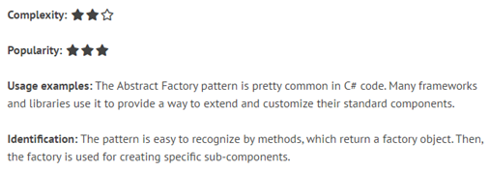
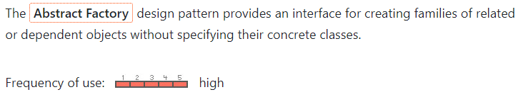
Resources:
https://refactoring.guru/design-patterns/abstract-factory/ https://refactoring.guru/design-patterns/abstract-factory/csharp/example
https://www.dofactory.com/net/abstract-factory-design-pattern
https://dotnettutorials.net/lesson/factory-design-pattern-csharp/

Slide 15
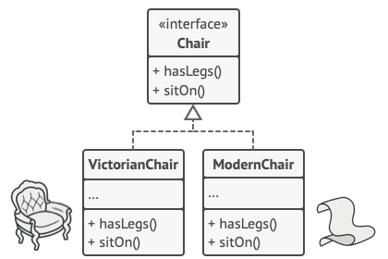
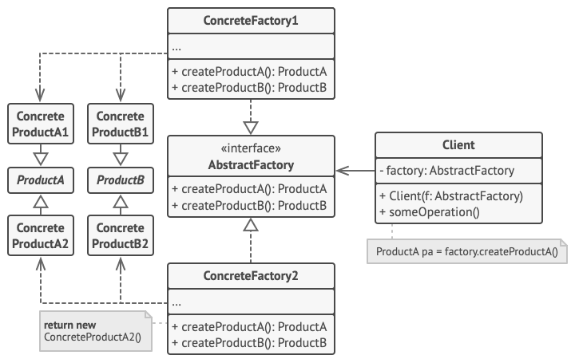
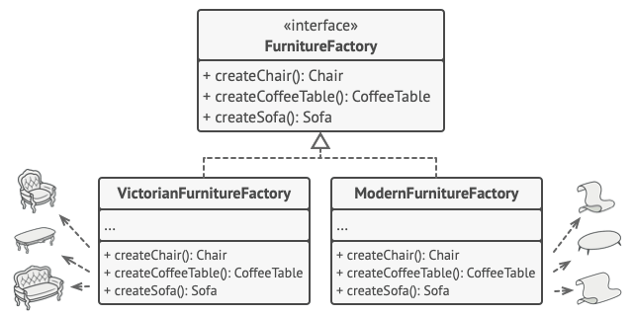
Overview:
1. Models
3. Structure
2. Factory

Slide 16
Nuances:
Which factory?
Q: Before starting your implementation, you should answer yourself a question what is the pragmatical usage and benefit of the Abstract Factory pattern.
A: For structured problem, when your models derives from each other and their types are known beforehand => choose Abstract Factory
When there is no relation between models, and there is some uncertainty (you do not know the exact types beforehand) => choose Factory Method
How to distinguish types?
Usually there is a convention to use enums, to determine what kind of object you are going to create, e.g.:
var cat = _animalsFactory.Create(Animals.Cat);
Of course, you can also decide to use: - string - number, etc. However, this solution is prone to typos and requires more effort during code maintenance
One of the implementations of Abstract Factory, is to define in the concrete factory body a Create() method, taking parameter to determine a type of object to be created. And inside of this method, placing switch-case statements returning very spe- cific implementations
Another approach, would be to create dedicated methods: “CreateCat()”, nonetheless this solution is not generic and would cost you a lot of additional effort to add new code and update the existing one

Slide 17
IMPLEMENTATIONS:
class Program
{
abstract class Position
{
public abstract string Title { get; }
}
class Manager : Position
{
public override string Title
{
get { return "Manager"; }
}
}
class Clerk : Position
{
public override string Title
{
get { return "Clerk"; }
}
}
class Programmer : Position
{
public override string Title
{
get { return "Programmer"; }
}
}
}
Popular, switch-case:
static class Factory
{
public static Position Create(int id)
{
switch (id)
{
case 0: return new Manager();
case 1: return new Clerk();
case 2: return new Programmer();
default:
return new Programmer();
}
}
}
Models:
Printing results:
Factory:
static void Main(string[] args)
{
for (int i = 0; i <= 2; i++)
{
var position = Factory.Create(i);
Console.WriteLine("Where id = {0}, position = {1} ", i, position.Title);
}
Console.ReadLine();
}

Slide 18
IMPLEMENTATIONS:
class Program
{
public interface IPosition
{
string Title { get; }
}
class Manager : IPosition
{
public string Title
{
get { return "Manager"; }
}
}
class Clerk : IPosition
{
public string Title
{
get { return "Clerk"; }
}
}
class Programmer : IPosition
{
public string Title
{
get { return "Programmer"; }
} }
}
Smart, generic:
static class Factory
{
public static T Create<T>() where T : IPosition, new()
{
return new T();
}
}
Factory:
Models:
Printing results:
static void Main(string[] args)
{
IPosition position0 = PositionFactory.Create<Manager>();
Console.WriteLine("0: " + position0.Title);
IPosition position1 = PositionFactory.Create<Clerk>();
Console.WriteLine("1: " + position1.Title);
IPosition position2 = PositionFactory.Create<Programmer>();
Console.WriteLine("1: " + position2.Title);
Console.ReadLine();
}

